Slide 1
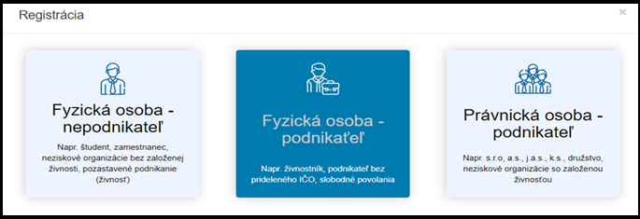
How to register in National Business Center
Select the business unit
Individual – non-entrepreneur (from Slide number 2)
For example – student, employee, non-profit organization without trade licence, suspend trading
Individual – entrepreneur (from Slide number 7)
For example – sole trader, entrepreneur without assigned company identification number, freelancers
Legal entity - entrepreneur (from Slide number 11)
For example – ltd, PLC, limited partnership, co-operative society, non-profit organization with trade licence
For workshop registration go to slide number 16

Slide 2
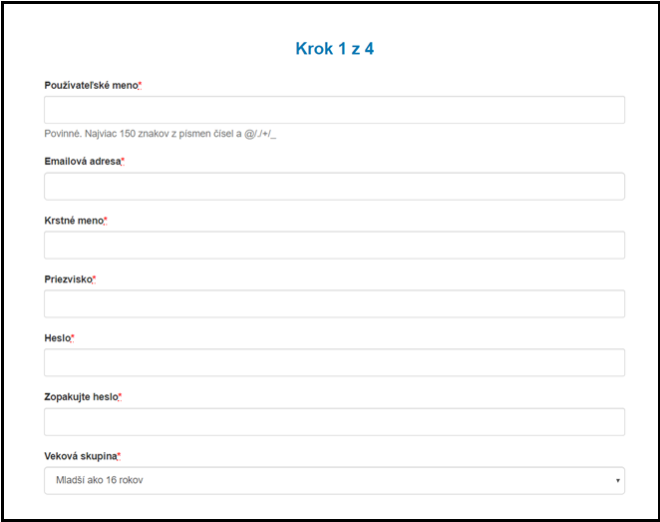
Individual- non entrepreneur
Step 1
  Username – mandatory, up to 150 letters and/or numbers
  Email address
  First name
  Surname
  Password
  Password again
  Age – less than 16 years old, 16-18 years old,
  18-35 years old, 35 years old and more
All the boxes with * are mandatory in order to proceed your registration

Slide 3
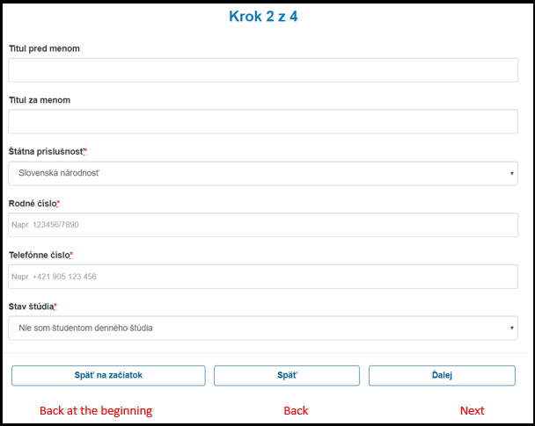
Individual- non entrepreneur
Step 2
Title before name
Title after name
Nationality
Personal Identification number
Phone number
Status of study :
I am not full-time student,
I am a full-time high school student,
I am a full-time student at the university
All the boxes with * are mandatory in order to proceed your registration

Slide 4
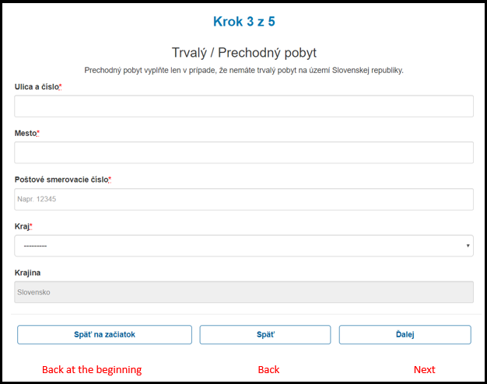
Individual- non entrepreneur
Step 3
Permanent/ Temporary residence
Temporary residence is filled only in case that you do not have
permanent address in Slovak Republic.
Address and street number
City
Postal Code
Region
Country
All the boxes with * are mandatory in order to proceed your registration

Slide 5
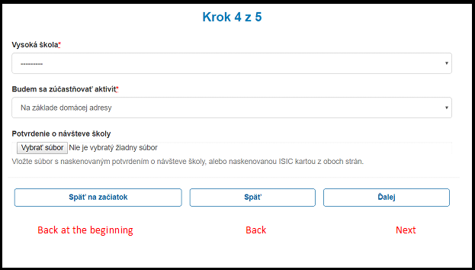
Individual- non entrepreneur
Step 4
University
I will attend workshops:
at my permanent address, school address
Verification of school visit:
add copy of confirmation from school or
scan of ISIC from both sides
All the boxes with * are mandatory in order to proceed your registration

Slide 6
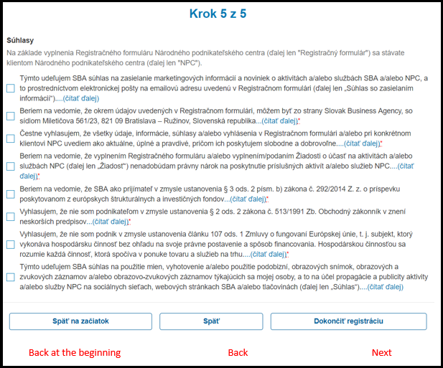
Individual- non entrepreneur
Step 5
Agreements
Based on these agreements, I give Slovak Business Agency rights to use my personal information in order to obtain services that I assigned to in this registration. I declare that all the information that I have provided are truthful, while I provide it freely and voluntarily.
Agreements with * are mandatory in order to continue with registration

Slide 7
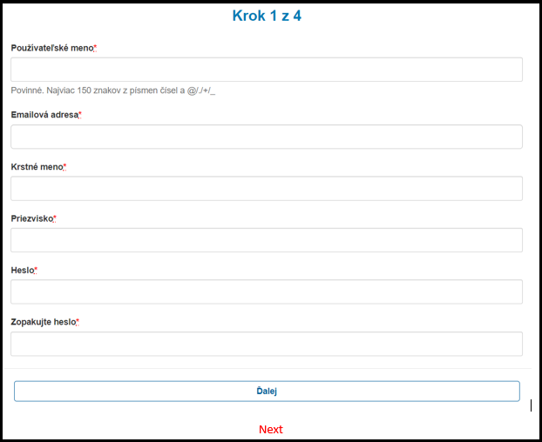
Individual- entrepreneur
Step 1
  Username – mandatory, up to 150 letters and/
  or numbers
  Email address
  First name
  Surname
  Password
  Password again
  Next
All the boxes with * are mandatory in order to proceed your registration

Slide 8
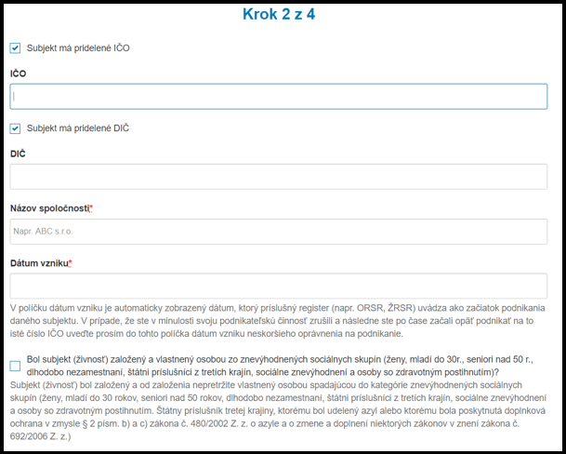
Individual- entrepreneur
Step 2
Subject has assigned company identification number
IČO - company identification number
Subject has assigned VAT ID
VAT ID
Company name
Registration date:
date of the establishment of the company in Slovakia
All the boxes with * are mandatory in order to proceed your registration
Has your company been founded and since its establishment continuously owned by a person (s) from disadvantaged social groups (women, young people under 30, seniors over 50, long-term unemployed, third-country citizens, socially disadvantaged and disabled)? The enterprise has been established and has since been consistently owned by a person belonging to the category of disadvantaged social groups, which has more than 50% of the share capital or voting rights in the enterprise. In the case of undertakings which have been established and have been consistently owned by several persons since their establishment, which fall under the category of disadvantaged social groups, their share capital or their voting rights in the enterprise should be calculated. Disadvantaged social groups are: women, young people under 30, older people over 50, long-term unemployed, third-country nationals, social disadvantages and people with disabilities. A third country citizens who has been granted asylum or who has been granted subsidiary protection within the meaning of § 2 (a). b) and c) of Act no. 480/2002 Coll. on Asylum and on amendments and supplements to certain acts as amended by Act no. 692/2006 Coll.

Slide 9
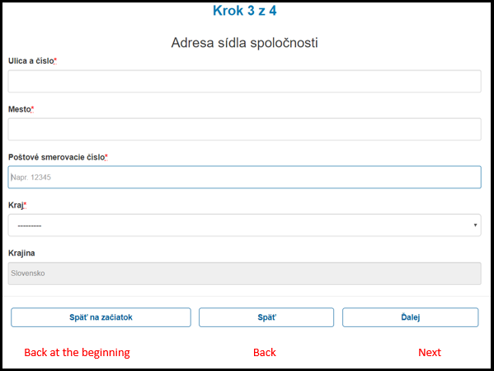
Individual- entrepreneur
Step 3
Address of the company:
Address and street number
City
Postal Code
Region
Country
All the boxes with * are mandatory in order to proceed your registration

Slide 10
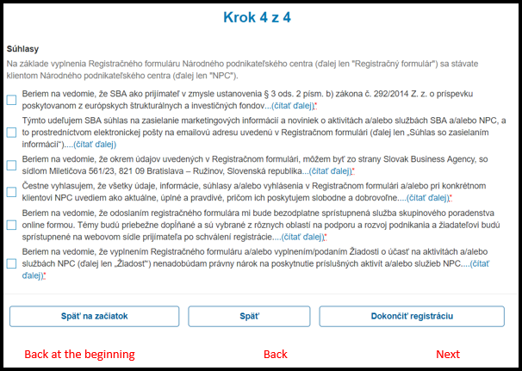
Individual- entrepreneur
Step 4
Agreements
Based on these agreements, I give Slovak Business Agency rights to use my personal information in order to obtain services that I assigned to in this registration. I declare that all the information that I have provided are truthful, while I provide it freely and voluntarily.
Agreements with * are mandatory in order to continue with registration.

Slide 11
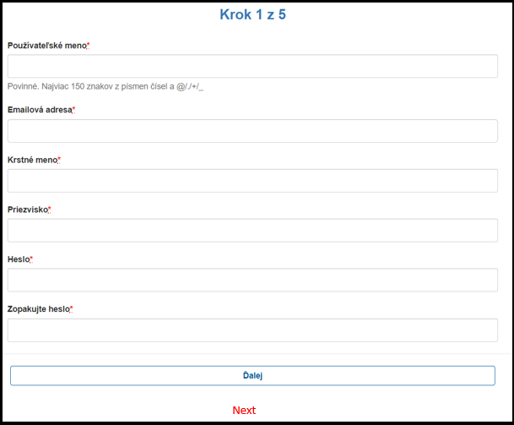
Legal entity – entrepreneur
Step 1
Username – mandatory, up to 150 letters and/
or numbers
Email address
First name
Surname
Password
Password again
Next
All the boxes with * are mandatory in order to proceed your registration

Slide 12
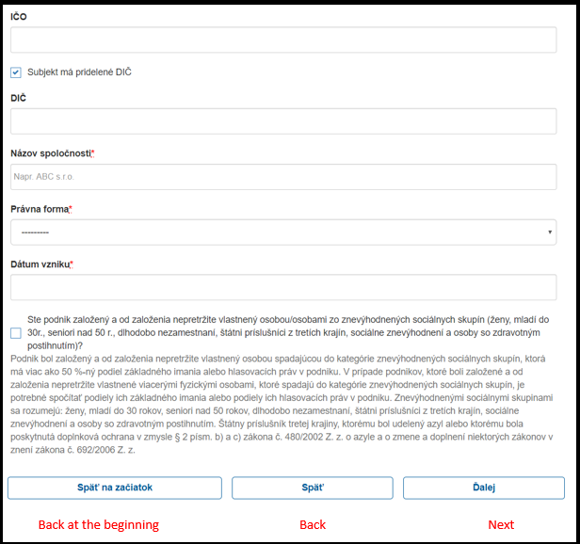
Legal entity - entrepreneur
Step 2
IČO - company identification number
Subject has assigned company identification number
VAT ID
Company name
Legal form
Registration date:
date of the establishment of the company in Slovakia
(All the boxes with * are mandatory in order to proceed your registration)
Has your company been founded and since its establishment continuously owned by a person (s) from disadvantaged social groups (women, young people under 30, seniors over 50, long-term unemployed, third-country citizens, socially disadvantaged and disabled)? The enterprise has been established and has since been consistently owned by a person belonging to the category of disadvantaged social groups, which has more than 50% of the share capital or voting rights in the enterprise. In the case of undertakings which have been established and have been consistently owned by several persons since their establishment, which fall under the category of disadvantaged social groups, their share capital or their voting rights in the enterprise should be calculated. Disadvantaged social groups are: women, young people under 30, older people over 50, long-term unemployed, third-country nationals, social disadvantages and people with disabilities. A third country citizens who has been granted asylum or who has been granted subsidiary protection within the meaning of § 2 (a). b) and c) of Act no. 480/2002 Coll. on Asylum and on amendments and supplements to certain acts as amended by Act no. 692/2006 Coll.

Slide 13
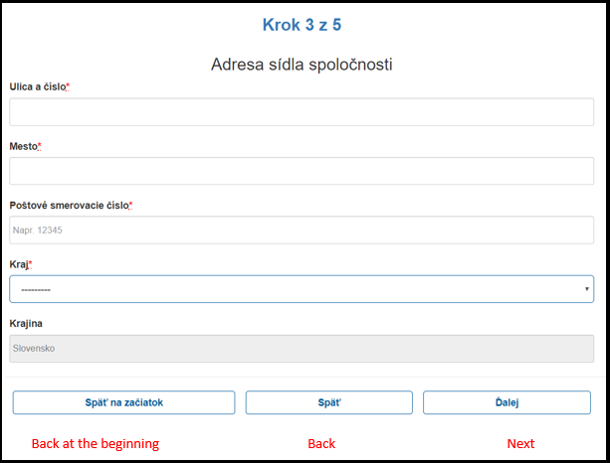
Legal entity - entrepreneur
Step 3
Address of the company:
Address and street number
City
Postal Code
Region
Country
All the boxes with * are mandatory in order to proceed your registration

Slide 14
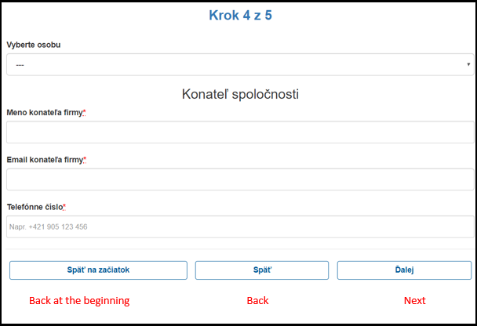
Legal entity - entrepreneur
Step 4
Pick a competent person that will attend a workshop
(executive manager)
Executive manager
Name of the executive manager
Email of the executive manager
Phone number
All the boxes with * are mandatory in order to proceed your registration

Slide 15
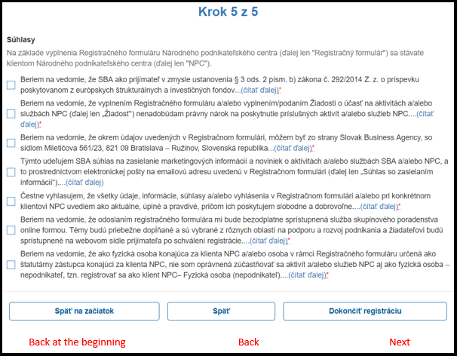
Legal entity - entrepreneur
Step 5
Agreements
Based on these agreements, I give Slovak Business Agency rights to use my personal information in order to obtain services that I assigned to in this registration. I declare that all the information that I have provided are truthful, while I provide it freely and voluntarily.
Agreements with * are mandatory in order to continue with registration.

Slide 16
Registration for workshop
Step 1
First you need to sign up (in case you did not sign up yet, please register)
Please note that:
After Registration in National Business Center you will receive confirmation email.
Only after confirming your email adress you can move to registration for workshop.

Slide 17
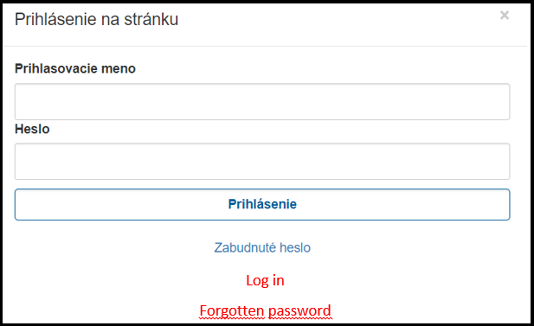
Registration for workshop
Step 2
Username
Password

Slide 18
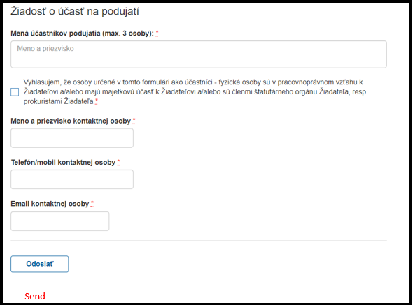
Registration for workshop
Step 3
Names of participants (max 3 persons)
I declare that the persons in this form as participants - individuals are in
an employment relationship with the applicant and / or have an ownership interest,
and / or are members of the applicant's statutory body *
Full name of the contact person
Phone/mobile number of the contact person
Email of the contact person
Send
*mandatory in order to sign up for workshop
All the boxes with * are mandatory in order to proceed your registration

